Slide 1
I/O fundamentals

Slide 2
Introduction
The I/O subsystem provides an efficient mode of communication between CPU and outside environment
Devices that are under the direct control of computer are said to be connected on-line
Input or output devices attached to the computer are also referred as peripherals.
I/O interface or I/O Module provides a method for transferring information between internal storage and external i/o devices.

Slide 3
Peripheral Devices
PERIPHERAL DEVICES
Input Devices
Output Devices
Keyboard
Optical input devices
- Card Reader
- Paper Tape Reader
- Bar code reader
- Digitizer
- Optical Mark Reader
Magnetic Input Devices
- Magnetic Stripe Reader
Screen Input Devices
- Touch Screen
- Light Pen
- Mouse
Analog Input Devices
Card Puncher, Paper Tape Puncher
CRT
Printer (Impact, Ink Jet,
Laser, Dot Matrix)
Plotter
Analog
Voice

Slide 4
I/O interface
Resolves the differences between the computer and peripheral devices
Peripherals - Electromechanical Devices
CPU or Memory - Electronic Device
- Data Transfer Rate
Peripherals - Usually slower
CPU or Memory - Usually faster than peripherals
Some kinds of Synchronization mechanism may be needed
- Unit of Information
Peripherals - Byte
CPU or Memory - Word
- Operating Modes
Peripherals - Autonomous, Asynchronous
CPU or Memory - Synchronous

Slide 5
I/O BUS AND INTERFACE MODULES
I/O bus
Data
Processor
Address
Control
Interface
Interface
Interface
Interface
Keyboard
Magnetic
Magnetic
and
Printer
disk
tape
display
terminal
Each peripheral has an interface module associated with it
Interface
- Decodes the device address (device code)
- Decodes the commands (operation)
- Provides signals for the peripheral controller
- Synchronizes the data flow and supervises
the transfer rate between peripheral and CPU or Memory
Typical I/O instruction
Op. code
Device address
Function code
(Command)

Slide 6
I/O Bus and Memory Bus
  Functions of Buses
  MEMORY BUS is for information transfers between CPU and the Main Memory
  * I/O BUS is for information transfers between CPU and I/O devices through their I/O interface
  * Many computers use a common single bus system for both memory and I/O interface units
  - Use one common bus but separate control lines for each function
  - Use one common bus with common control lines for both functions
  * Some computer systems use two separate buses,
  one to communicate with memory and the other with I/O interfaces

Slide 7
Isolated I/O
Isolated I/O
- Separate I/O read/write control lines in addition to memory read/write control lines.
Separate (isolated) memory and I/O address spaces .
Distinct input and output instructions.
When CPU fetches and decodes the opcode of an I/O instruction, it places the address into the common address lines. Also enables read/write control lines => the address in the address lines is for interface register and not for a memory word.

Slide 8
Memory Mapped I/O
Memory mapped I/O
  - A single set of read/write control lines
  (no distinction between memory and I/O transfer)
  - Memory and I/O addresses share the common address space
  -> reduces memory address range available
  -> Memory addresses xffff0000 and above are used for I/O devices
  - No specific input or output instruction
  -> The same memory reference instructions can be used for I/O transfers
  -> when the bus sees certain addresses, it knows they are not memory addresses, but are addresses for accessing I/O devices.
  - Considerable flexibility in handling I/O operations

Slide 9
Data
Address
Read
Write
Main Memory
CPU
IO Port 1
IO Port 2
IO Port 3
Memory-Mapped I/O
IO Device A
IO Device B
Data
Address
Read M
Read IO
Write M
Write IO
Main Memory
CPU
IO Port 1
IO Port 2
IO Port 3
IO Device A
IO Device B
I/O Mapped I/O

Slide 10
Asynchronous Data Transfer
Synchronous and asynchronous operations
Synchronous - All devices derive the timing information from common clock line
Asynchronous - No common clock
Asynchronous Data Transfer
Asynchronous data transfer between two independent units requires that control signals be transmitted between the communicating units to indicate the time at which data is being transmitted
Two Asynchronous Data Transfer Methods
Strobe pulse
- A strobe pulse is supplied by one unit to indicate the other unit when the transfer has to occur
Handshaking
- A control signal is accompanied with each data being transmitted to indicate the presence of data
- The receiving unit responds with another control signal to acknowledge receipt of the data

Slide 11
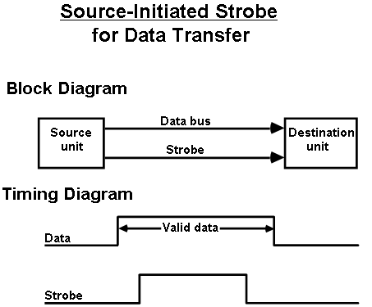
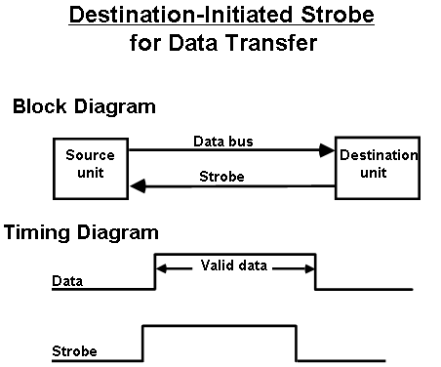
Strobe Control
Employs a single control line to time each transfer
The strobe may be activated by either the source or the destination unit
Data bus carries the binary information from source to destination

Slide 12
Source initiated strobe
It could be a memory write control signal from the CPU to a memory unit.
Source is the CPU, places a word on the data bus and informs the memory unit which is destination, that this is a write operation
Disadvantage – no way of knowing whether the destination unit has actually received data

Slide 13
Destination initiated strobe
It could be a memory read control signal.
CPU, the destination initiates the read operation to inform the memory which is the source to place a selected word into the data bus.
Disadvantage - no way of knowing whether the source has actually placed the data on the bus

Slide 14
Hand Shaking
To solve the disadvantages of strobe, the HANDSHAKE method introduces a second control signal to provide a Reply to the unit that initiates the transfer.
2 types
  Source initiated transfer
  Destination initiated transfer
Provides high degree of flexibility and reliability
Incompletion of data transfer can be detected by means of a timeout mechanism
The timeout signal can be used to interrupt the processor and hence execute a service routine that takes appropriate error recovery action.

Slide 15
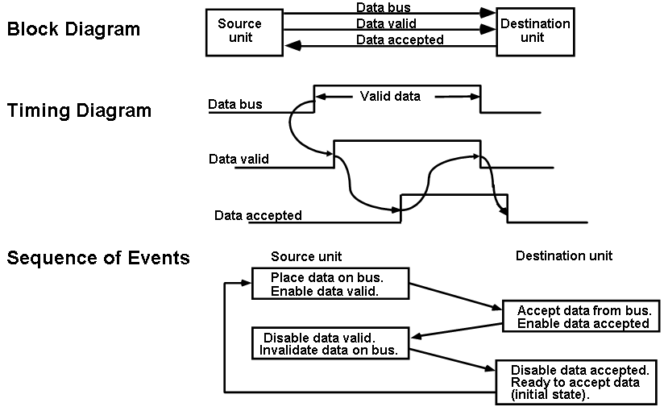
SOURCE-INITIATED TRANSFER USING HANDSHAKE

Slide 16
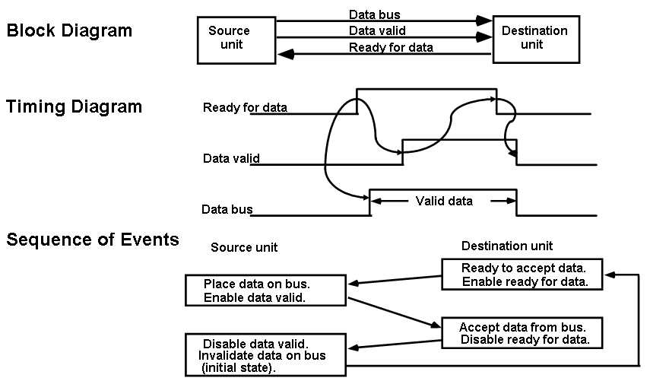
DESTINATION-INITIATED TRANSFER USING HANDSHAKE

Slide 17
Modes of Transfer
3 different Data Transfer Modes between the central computer (CPU or Memory) and peripherals;
  Program-Controlled I/O or programmed I/O
  Interrupt-Initiated I/O or Interrupt driven I/O
  Direct Memory Access (DMA)
Programmed I/O
  Transferring data under program control requires constant monitoring of the peripheral by CPU.
  I/O device does not have direct access to memory
  Programmed I/O is time consuming process since it keeps the processor busy needlessly.

Slide 18
Programmed I/O
More instructions may be required during the transfer of data from I/O device to memory
  Input instruction: from I/P device to CPU
  Store instruction: CPU->memory
  To verify the data availability
  To count the number of words transferred
A common programming task is to transfer a block of words from an I/O device and store them in a memory buffer
Useful in small low speed systems or in dedicated systems to monitor a device continuously.

Slide 19
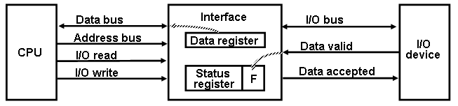
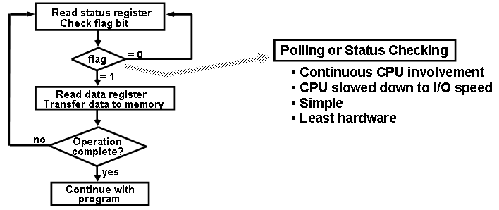
Programmed I/O
Data Transfer from I/O device to CPU
Flow chart for CPU program to input data

Slide 20
Interrupt
An interrupt is a signal from a device attached to a computer or from a program within the computer that causes the CPU to stop its normal program execution and perform service related to the event.
Examples of interrupts :I/O completion, divide-by-0, etc.
Maskable Interrupt: It is a hardware interrupt that may be ignored by setting a bit in an interrupt mask register's (IMR) bit-mask.
Non-maskable Interrupt: is a hardware interrupt that does not have a bit-mask associated with it - meaning that it can never be ignored. NMIs are often used for timers, especially watchdog timers

Slide 21
Interrupt-Initiated I/O
When the interface determines that the I/O device is ready for data transfer, it generates an Interrupt Request to the CPU .
Upon detecting an interrupt, CPU stops momentarily the task it is doing, branches to the service routine to process the data transfer, and then returns to the task it was performing

Slide 22
2 methods in which the CPU chooses the branch address of the service routine
  Non-vectored interrupt
    Branch address is assigned to a fixed location
    User has to provide address of subroutine using a CALL instruction
  Vectored interrupt
    Interrupt supplies the branch info (direct or indirect address of ISR) to the CPU
    Processor automatically generates the subroutine address

Slide 23
Priority Interrupt
Establishes priority over the various sources to determine which condition is to be serviced first when two or more requests arrive simultaneously.
The system may also determine which conditions are permitted to interrupt the computer while another interrupt is being serviced.
Priority can be established by software or hardware

Slide 24
Polling-S/W
Software Priority – polling – common branch address for all interrupts. Program to perform the test will be stored in this common branch address.
Highest priority source is tested first and if its interrupt signal is on, control branches to a service routine for this source.
Otherwise, the next-lower priority source is tested and so on.
Disadvantage – if many interrupts, time required to poll them may exceed the time available to service the I/O device.

Slide 25
Vectored Interrupts-H/W
Then, hardware priority interrupt unit can be used to speed up the operation.
Hardware priority interrupts – accepts interrupt request from many sources, determines which of the incoming requests has the highest priority and issues an interrupt request to the computer.
Here, each interrupt source has its own interrupt vector to access its own service routine directly.
Hardware priority interrupts – Serial or Parallel connection of interrupt lines.

Slide 26
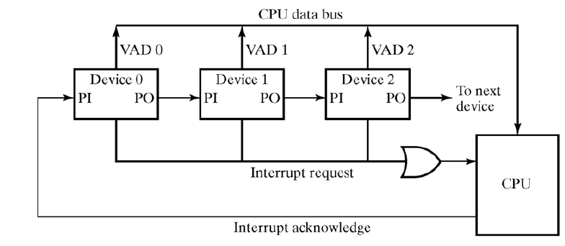
Serial - Daisy chaining
Serial hardware priority function
* Interrupt Request Line
- Single common line
* Interrupt Acknowledge Line
- Daisy-Chain

Slide 27
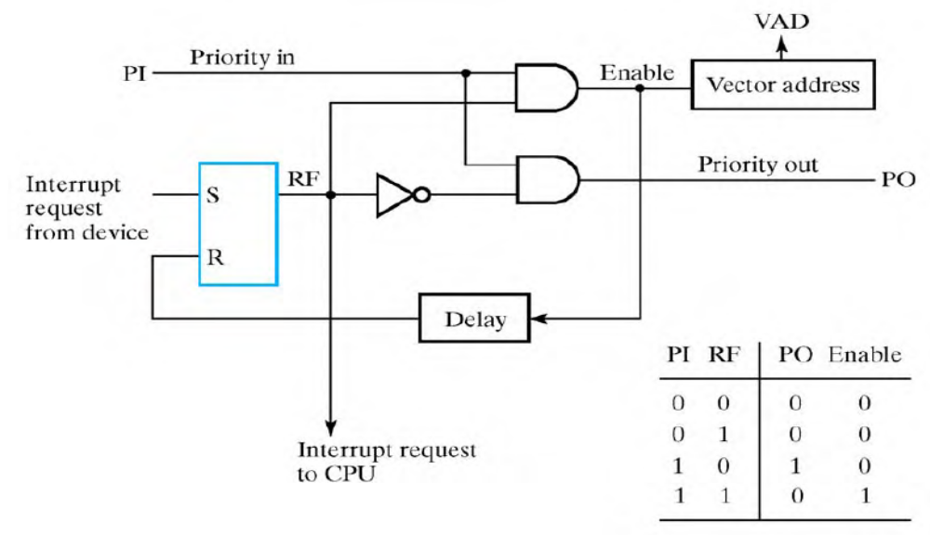
One stage of daisy chain priority interrupt scheme
If PI = 0, both PO and the enable line to VAD (vector address) are equal to 0, irrespective of RF.

Slide 28
If PI = 1 and RF = 0, then PO = 1 and the vector address is disabled => passes the acknowledge signal to the next device through PO.
The device is active when PI = 1 and RF = 1. This condition places a 0 in PO and enables the vector address for the data bus.
The RF flip-flop is reset after a sufficient delay to ensure that the CPU has received the vector address.

Slide 29
Parallel Priority Interrupt
Uses a register whose bits are set separately by the interrupt signal from each device.
Priority is established according to the position of the bits in the register.
Mask register is used to disable lower priority interrupts while a higher priority device is being serviced.
It can also provide a facility that allows a high-priority device to interrupt the CPU while a lower priority device is being serviced

Slide 30
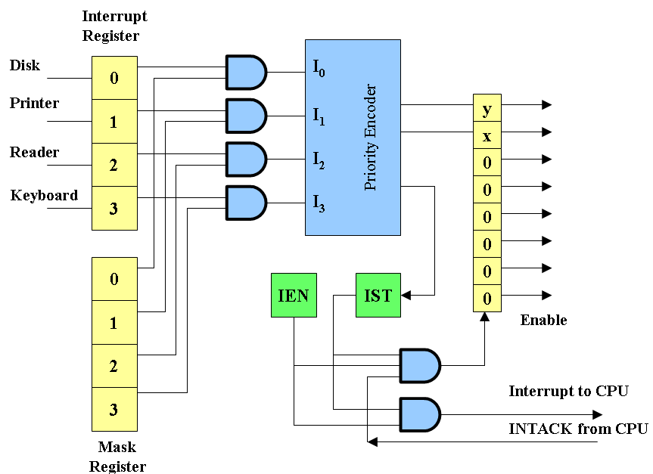
Mask register has a same number of bits as the interrupt register.
By means of program instructions, it is possible to set or reset any bit in the mask register.

Slide 31
The priority encoder generates two bits of the vector address, which is transferred to the CPU.
Another output from the encoder sets an interrupt status flip-flop IST when an interrupt that is not masked occurs.
The interrupt enable flip-flop IEN can be set or cleared by the program to provide an overall control over the interrupt system.
IST ANDed with IEN provide a common interrupt signal for the CPU.
The INTACK signal from the CPU enables the bus buffers in the output register and a vector address VAD is placed into the data bus.

Slide 32
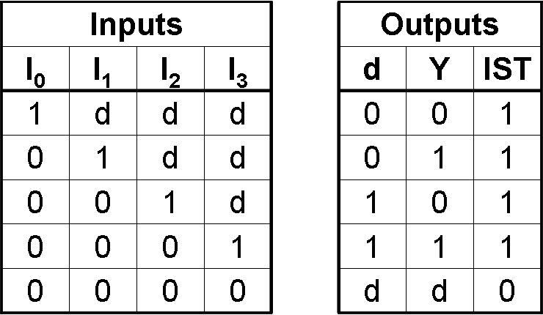
Priority encoder
Circuit that implements the priority function.
Logic – if two or more inputs arrive at the same time, the input having the highest priority will take precedence.
Boolean functions
X = I’₀I’₁ Y = I’₀I₁ + I’₀I’₂ IST = I₀ + I₁ + I₂ + I₃

Slide 33
Interrupt
An interrupt is a signal from a device attached to a computer or from a program within the computer that causes the CPU to stop its normal program execution and perform service related to the event.
Maskable Interrupt: It is a hardware interrupt that may be ignored by set/reset a bit in an interrupt mask register's (IMR) bit-mask.
Non-maskable Interrupt: is a hardware interrupt that does not have a bit-mask associated with it - meaning that it can never be ignored. NMIs are often used for timers, especially watchdog timers

Slide 34
Interrupt Cycle
The Interrupt enable flip-flop (IEN) can be set or cleared by program instructions.
A programmer can therefore allow interrupts (clear IEN) or disallow interrupts (set IEN)
At the end of each instruction cycle the CPU checks IEN and IST. If either is equal to zero, control continues with the next instruction. If both = 1, the interrupt is handled.
Interrupt micro-operations:
  SP←SP – 1 (Decrement stack pointer)
  M[SP] ← PC Push PC onto stack
  INTACK ← 1 Enable interrupt acknowledge
  PC ←VAD Transfer vector address to PC
  IEN ←0 Disable further interrupts
  Go to fetch next instruction

Slide 35
Interrupt Service Routine
An interrupt handler, also known as an interrupt service routine (ISR), is a callback subroutine in an operating system whose execution is triggered by the reception of an interrupt. Interrupt handlers have a multitude of functions, which vary based on the reason the interrupt was generated.
Interrupt Overhead
The interrupt overhead is caused by context switching (storing and restoring the state of CPU )
On interrupt handler entry, the context of the current process and its thread must be saved. On exit, it must be restored.
On handler entry, memory locations different from the memory locations in the cache are used, and therefore cache updates are required.

Slide 36
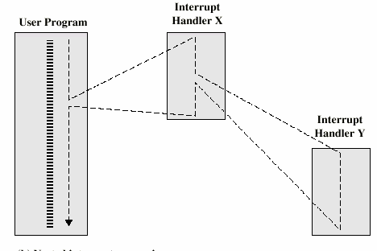
Interrupt nesting
An interrupt can happen while executing an ISR. This is called interrupt nesting.

Slide 37
Role of CPU in transfer of information
peripheral device -> CPU -> memory
CPU limits the speed of transfer
Peripheral device -> memory
Transfer speed increases
Peripheral device manage the memory bus directly.
DMA (Direct memory Access)
CPU is idle

Slide 38
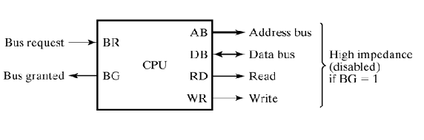
CPU Bus Signals for DMA Transfer
DMA Controller sends Bus Request to CPU
CPU stops execution of current instruction and places address bus, data bus, read and write lines into high impedance state.
CPU activates Bus Grant
After transfer DMA disables BR
CPU continues normal operation

Slide 39
Different ways of DMA transfer
Burst transfer – a block sequence consisting of a number of memory words is transferred in a continuous burst => need for fast devices
Cycle stealing – transfer one word at a time, after which it must return control of the buses to the CPU.
  CPU delays 1 cycle to allow Direct Memory I/O transfer

Slide 40
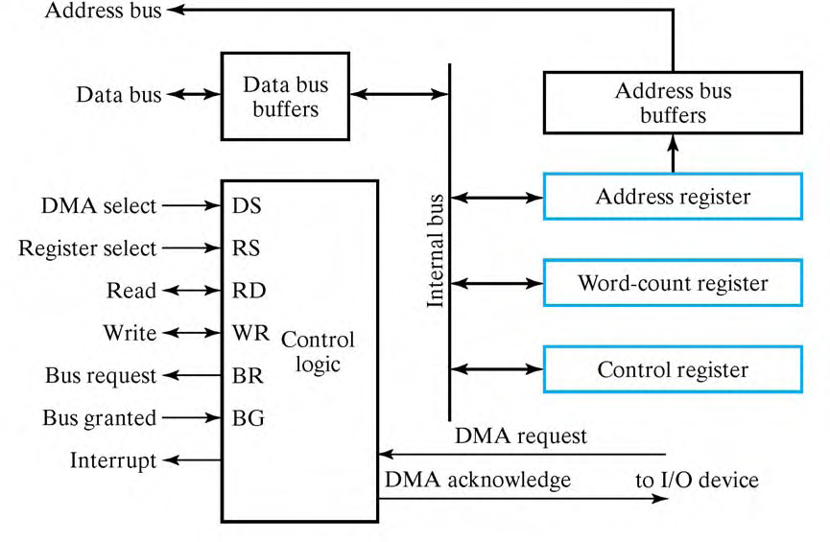
DMA Controller

Slide 41
DMA Controller contd.,
Three registers
  Address registers – to specify the desired location in memory
    Incremented after each word transfer
  Word count registers – numbers of words to be transferred
    Decremented after each word transfer and tested for 0.
  Control register – specifies mode of transfer

Slide 42
DMA Controller
Data bus and control lines => used to communicate with CPU
Registers in DMA are selected by CPU through address bus by enabling DS and RS inputs.
BG = 0 => CPU reads from or writes to the DMA registers
BG = 1 => DMA directly communicates with Memory by specifying address in address bus and activates the RD or WR control.
Request and acknowledge signals are used to communicate with peripheral devices

Slide 43
Initialization of DMA
CPU initializes DMA by sending the following information through data bus
  Starting address of the memory block where data are available (for read) or where data are to be stored (for write)
  The word count
  Control – to read or write
  A control to start the DMA transfer
After initialization, CPU stops communicating with DMA unless it receives an interrupt signal or if it wants to checks how many words have been transferred.

Slide 44
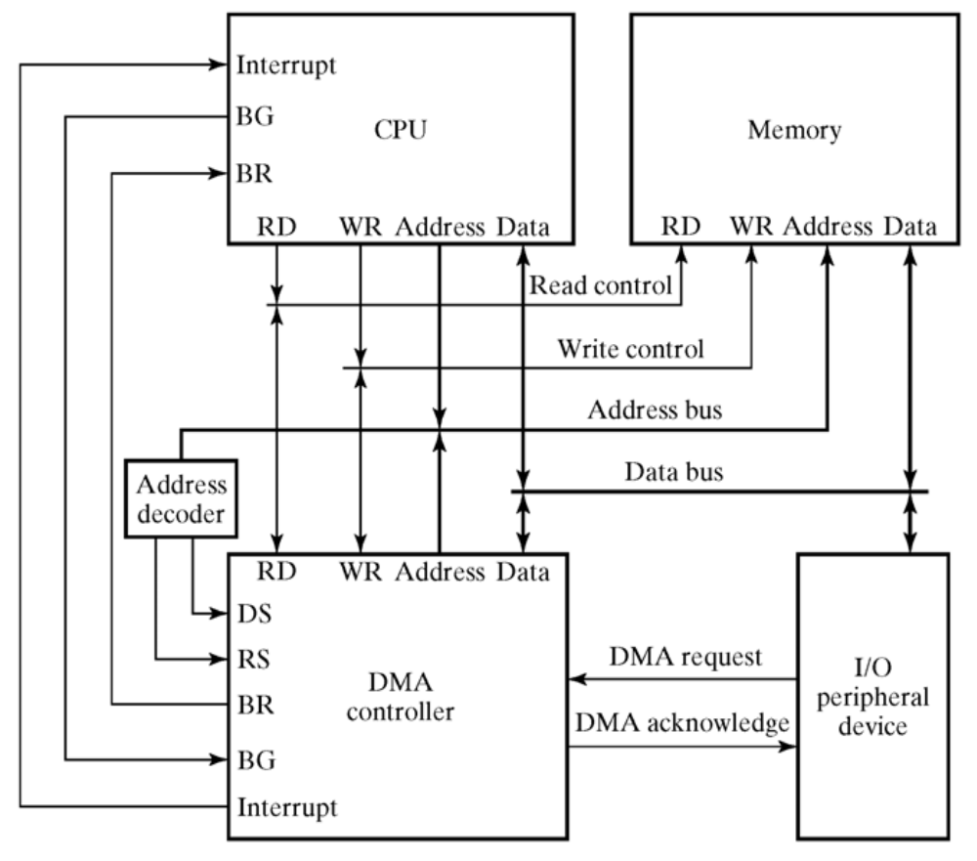
DMA Transfer

Slide 45
DMA Transfer
Bus Request
Peripheral device ----------> DMA controller -----------> CPU -----------> DMA controller
DMA controller puts the current value of its address register onto address bus, activates RD or WR signal, and --------------> peripheral device
RD and WR are bidirectional
  BG = 0 => CPU communicates with the internal DMA registers
  BG = 1 => RD and WR are output lines from DMA controller to the RAM to specify read or write operation for data
DMA Request
Bus grant
DMA Acknowledge

Slide 46
DMA contd.,
When the peripheral device receives a DMA acknowledge, it puts a word onto data bus or receives a word from data bus
For each word transfer, DMA increments address register and decrements word count register.
If WC = 0, DMA disables Bus request.
Termination is informed to CPU by means of interrupt signal.
When CPU receives interrupt signal, it checks value of word count register.

Slide 47
Application
Fast transfer of information between magnetic disk and memory
Updating the display in an interactive terminal

Slide 48
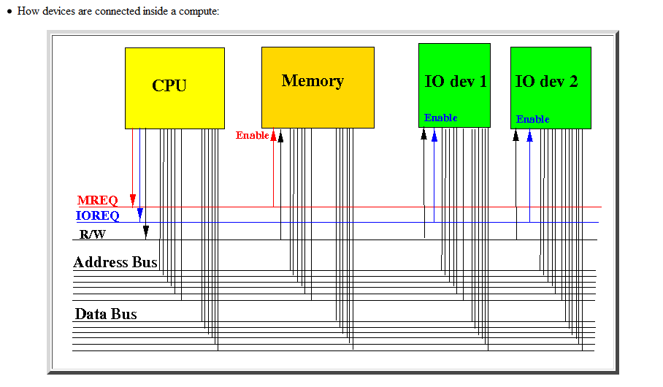
Bus System

Slide 49
Synchronous Bus
Synchronous bus (e.g., processor-memory buses)
  Includes a clock in the control lines and has a fixed protocol for communication that is relative to the clock
  Advantage: involves very little logic and can run very fast
  Disadvantages:
    Every device communicating on the bus must use same clock rate

Slide 50
Asynchronous Bus
Asynchronous bus (e.g., I/O buses)
  It is not clocked, so requires a handshaking protocol and additional control lines (ReadReq, Ack, DataRdy)
  Advantages:
    Can accommodate a wide range of devices and device speeds
  Disadvantage: slow(er)

Slide 51
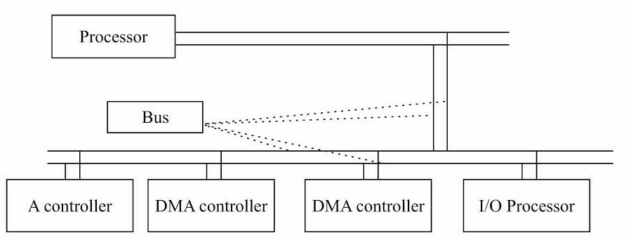
Bus Arbitration
A bus (any bus) cannot be used by more than one device at one time due to electrical properties of the devices.

Slide 52
Bus Arbitration
Before any device is allowed to perform a read/write operation using the system bus, it must first obtain permission.
A device that starts a read/write operation is called a master device
The device that it "talks" to is called the slave device

Slide 53
Bus Arbitration
Only one processor or controller can be bus master
• The bus master─ the controller that has access to a bus at an instance.
• Any one controller or processor can be the bus master at the given instance (s).

Slide 54
Bus Arbitration Methods
Centralized
Centralized bus arbitration requires hardware (arbiter)that will grant the bus to one of the requesting devices. This hardware can be part of the CPU or it can be a separate device on the motherboard.
  Single hardware device controlling bus access
    Bus Controller
    Arbiter
Decentralized
Decentralized arbitration there isn't an arbiter, so the devices have to decide who goes next. This makes the devices more complicated, but saves the expense of having an arbiter.
  Each module may claim the bus
  Control logic on all modules

Slide 55
Centralized Bus Arbitration
Centralized One Level Bus Arbiter
  This method of arbitration uses one centralized bus controller that all devices can query.
Centralized Two Level Bus Arbiter
  Uses a Bus Request Line and Bus Grant Line for each Level

Slide 56
3 BUS ARBITRATION METHODS
1. Daisy Chain
2. Independent Bus Requests and Grant
3. Polling

Slide 57
Centralized One Level Bus Arbitration
This method of arbitration uses one centralized bus controller that all devices can query. There are 2 lines that are used:
1. Bus Request Line – A wired ‘OR’ that the controller knows a request was made, but does not know which device made the request.
2. Bus Grant Line – First a signal is propagated to all devices. The Bus Grant Line is asserted to the first device in the chain. If that device made the request it takes a hold of the bus and leaves the Bus Grant Line negated for the next device in the chain. If that device didn’t make the request then the Bus Grant Line is asserted for the next device in the chain.
If two devices make a request for the bus at the same time then the device closer to the controller gets the bus. This is called daisy chaining

Slide 58
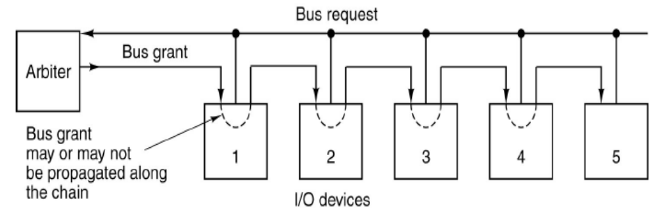
A centralized bus arbiter using daisy chaining

Slide 59
Centralized Two Level Bus Arbitration
Centralized Two Level Bus Arbiter
  Bus Request line: one for each level
  Bus Grant line: one for each level
  This Helps to alleviate the problem of the closest device to the
  controller getting control of the bus. If more than one request
  comes in at one time, control is granted based on priority. One
  major advantage to this is when a lower priority device has control
  of the bus, a higher priority device cannot ‘steal’ the bus from
  that device.

Slide 60
Independent Requesting
U₁
U₂
…
U_{n}
The bus controller determines priority, which is programmable.
Drawback: 2n Bus request and bus grant lines to control n devices, whereas daisy chaining requires 2 such lines and polling requires log₂n lines approximately.
Bus Controller
Bus Grant1
Bus Request1
Bus Grant2
Bus Request2
Bus Grant n
Bus Request n
Bus Busy
Bus

Slide 61
polling
Unit requests the bus via BUS request line.
In response, the Bus controller proceeds to generate a sequence of numbers on the poll-count lines.
Each unit compares to the unique address assigned to it.
When requesting unit finds the match, Bus Busy signal is activated.
In response, bus controller terminates the polling process and U_{i} connects to the bus.
Advantage: failure of one unit need not affect the other units.
Disadvantage: expensive because of more control lines. Number of units are limited based on the poll-count lines capability

Slide 62
Polling
U₁
U₂
U_{n}
Bus Controller
…
Poll
Count
Bus
Bus Request
Bus Busy

Slide 63
Daisy chaining, the centralized controller always sending bus control to highest priority, which passes it to next if bus access not required.
Independent request method, the centralized controller listens to requests of each device individually and grant access to the bus on resolving its priority.
Polling methods method, the centralized controller does the polling of the devices and grant access to that bus which requests it on receiving the poll address.

Slide 64
References
M. M. Mano, Computer System Architecture, Prentice-Hall

